Slide 1
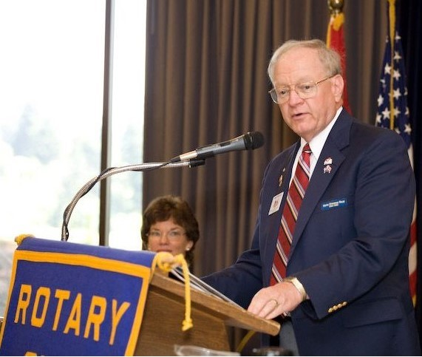
Brian Beagle – 44 Years in Silverdale Rotary – 1 of 3
Joined 1980
President 1985-86
D5020 Conference Co-Chair 2003
D5020 Area 9 Asst Governor 2003-2005
District Governor 2008-09
D5020 Foundation Chair 2009-2013
D5020 Rep - 2016 RI Council on Legislation

Slide 2
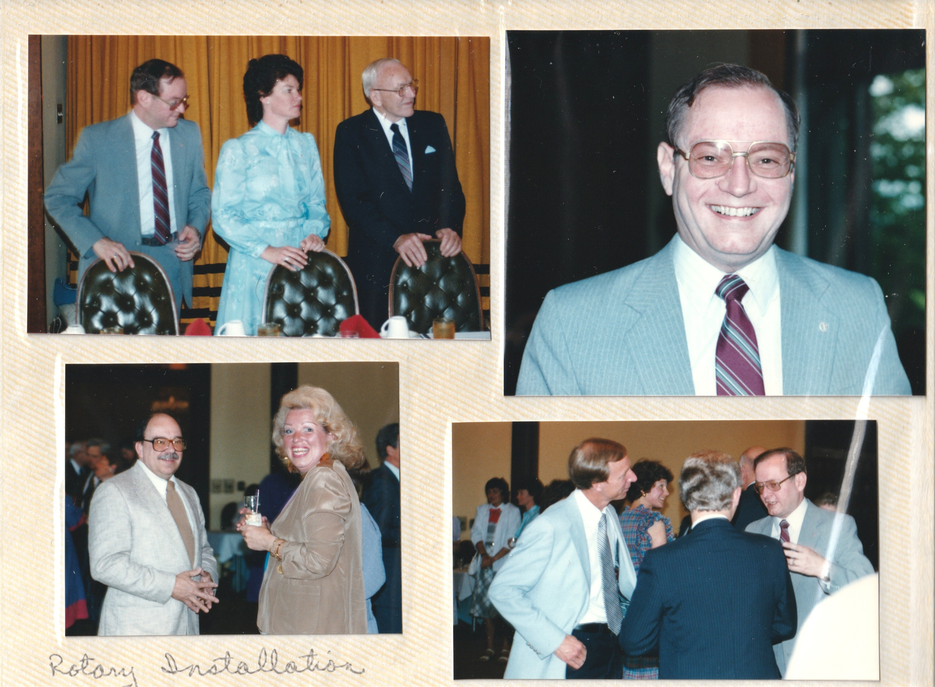
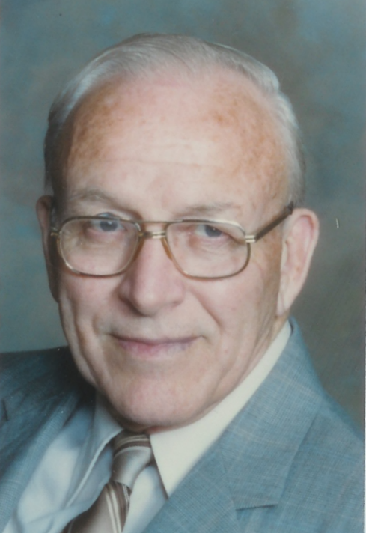
Club President 1985-86
Installed by his Dad Kenneth Beagle - PDG 1962-63

Slide 3
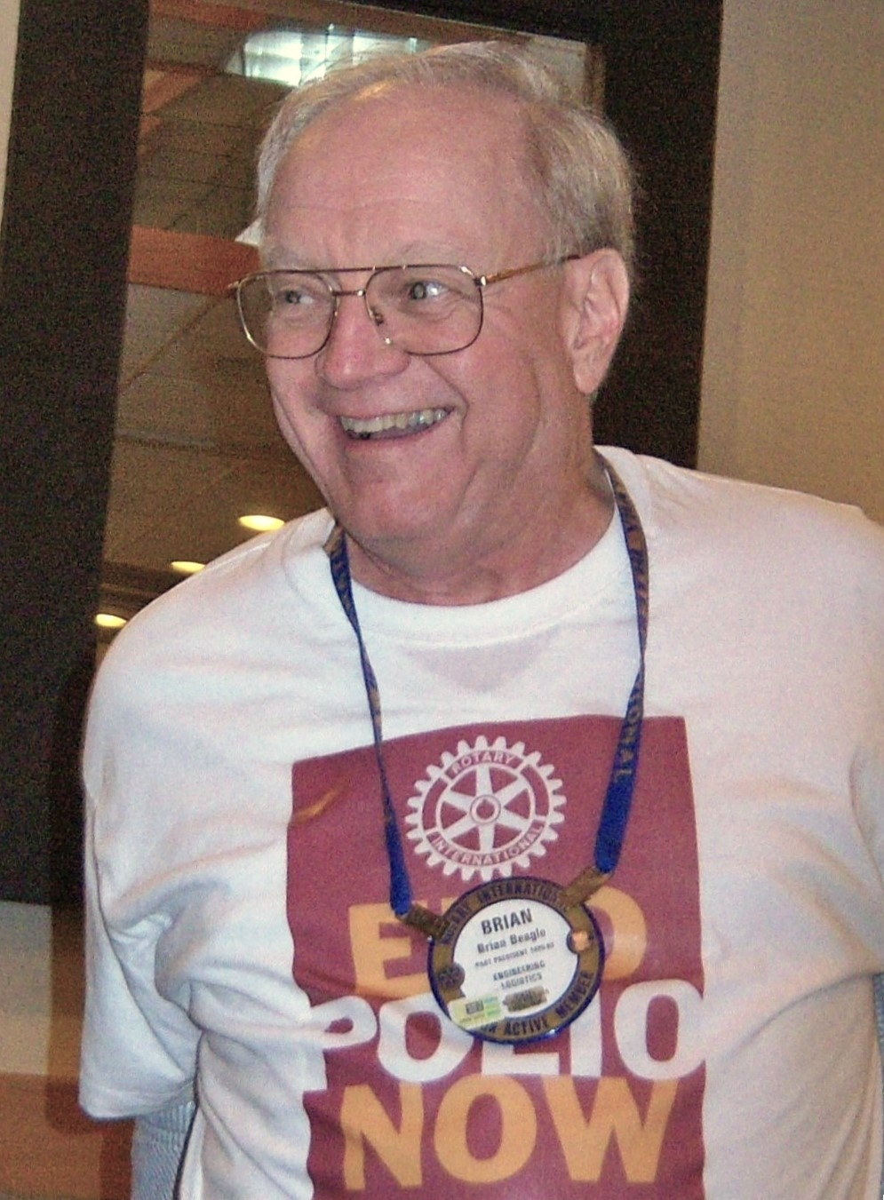
The Early Days – Polio Plus Starting in 1987
First Polio Plus Campaign
Polio Eradication Advocate for 37 years

Slide 4
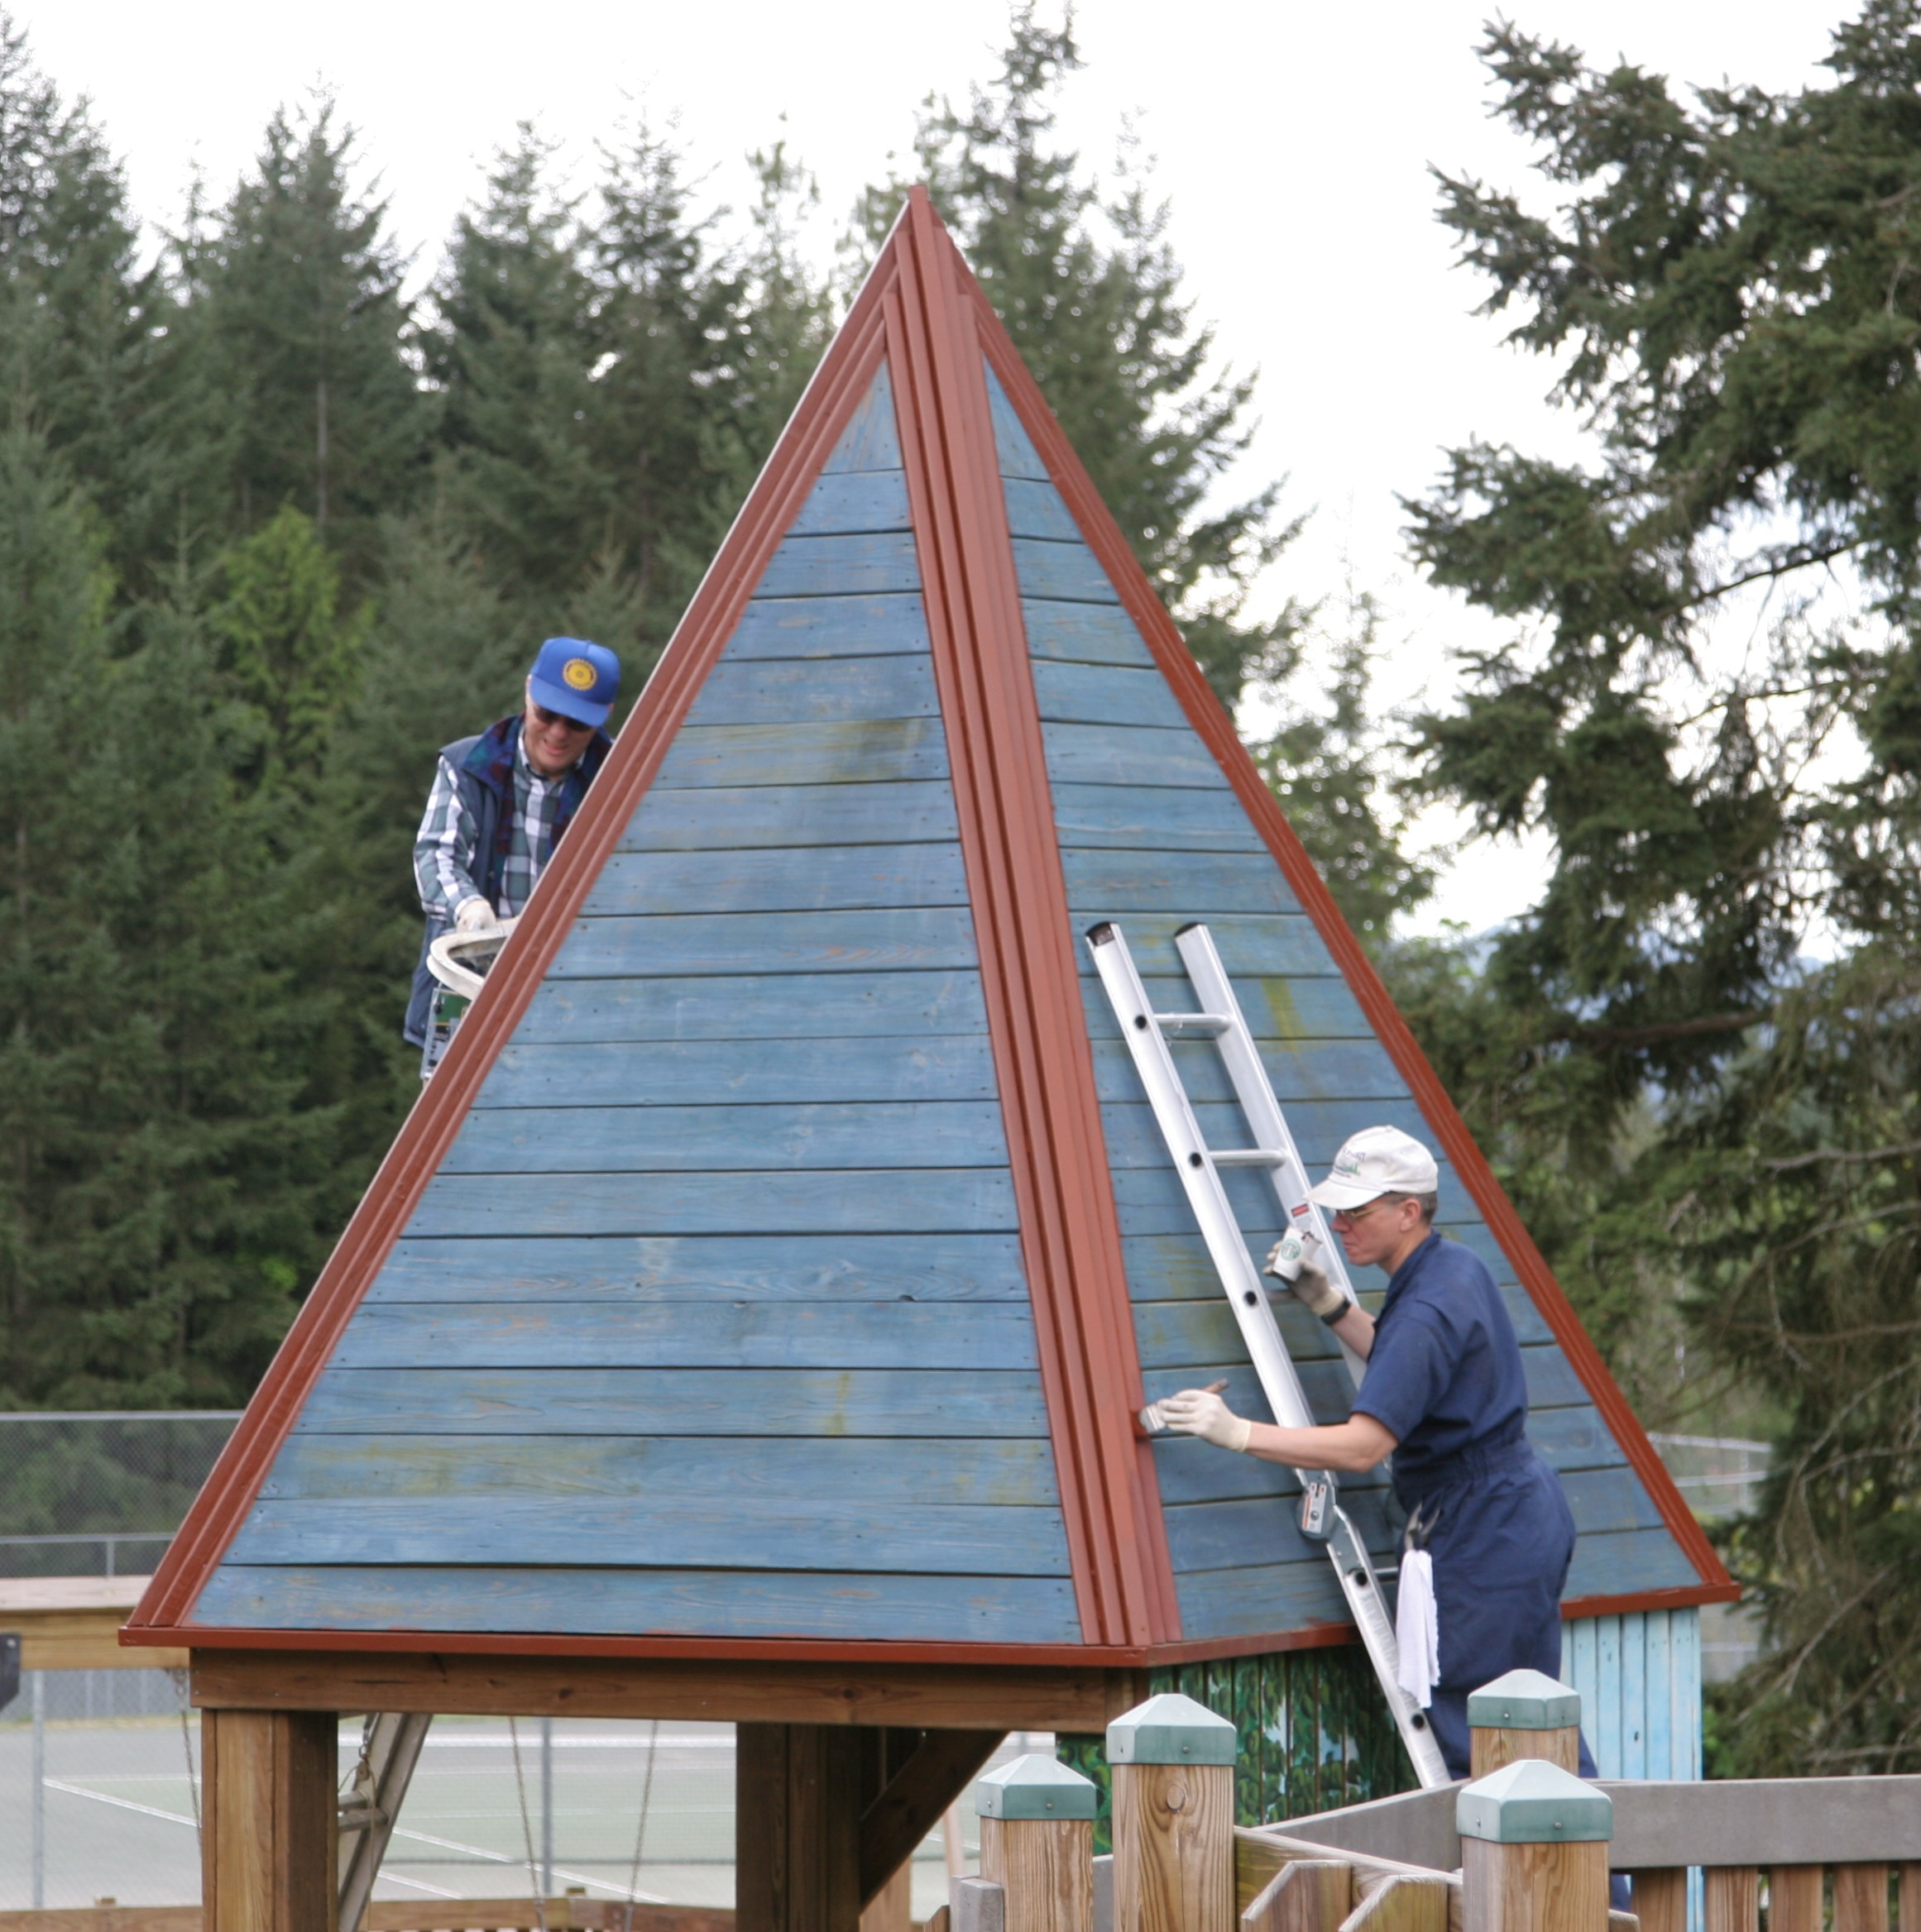
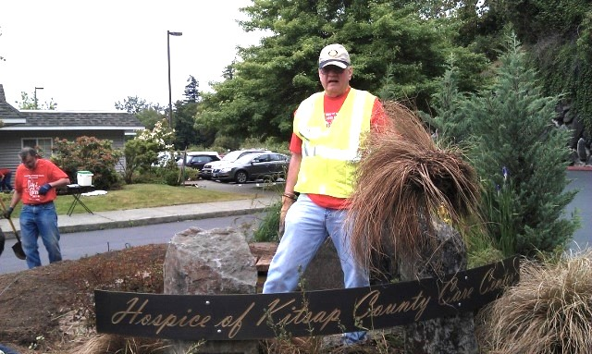
The Early Days – Work Parties
Hospice
Kitsap Place

Slide 5
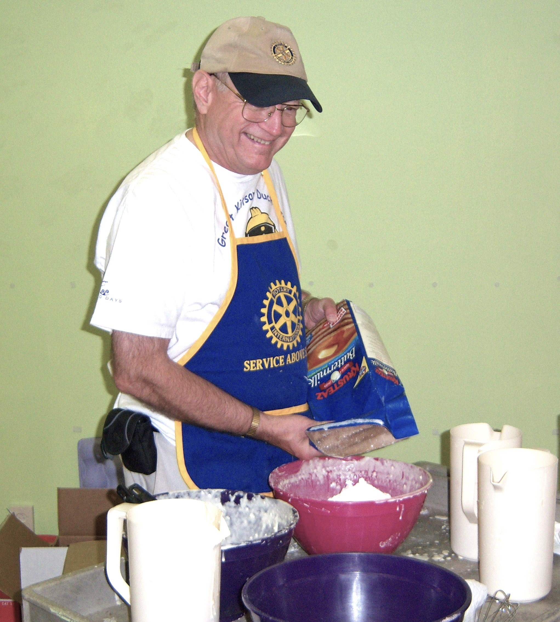
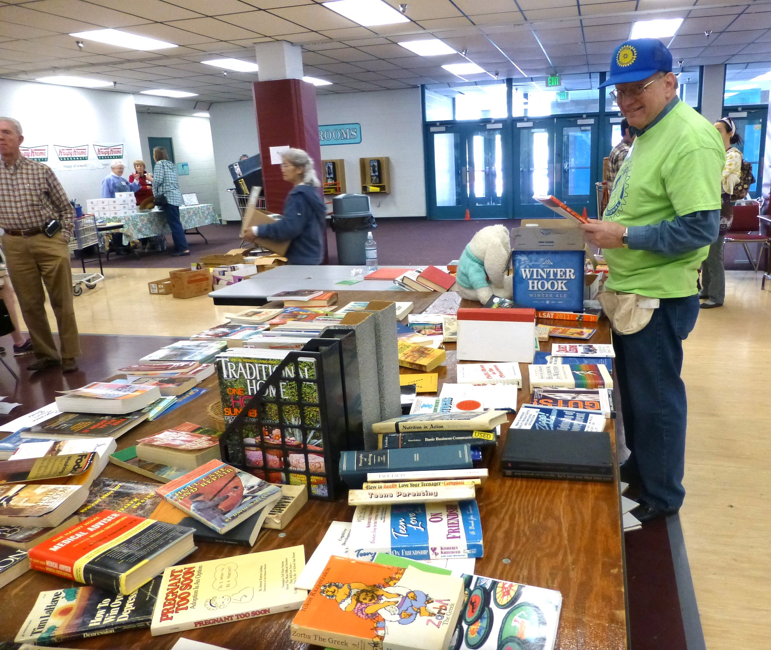
The Early Days
RAGS – the Book Guy
Pancake Breakfast

Slide 6
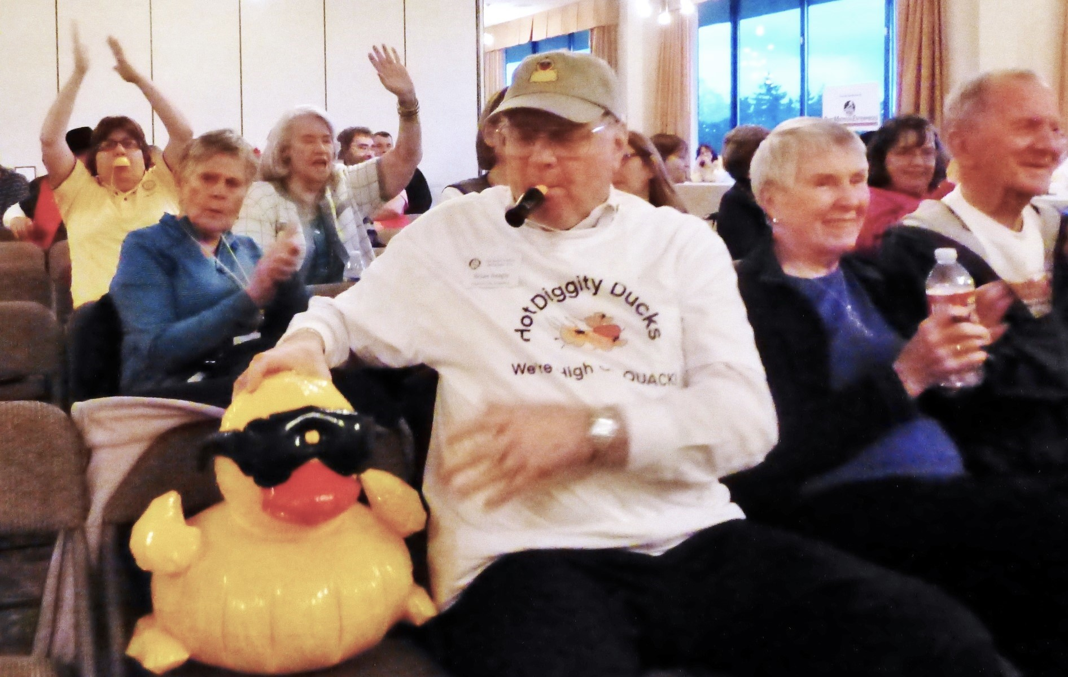
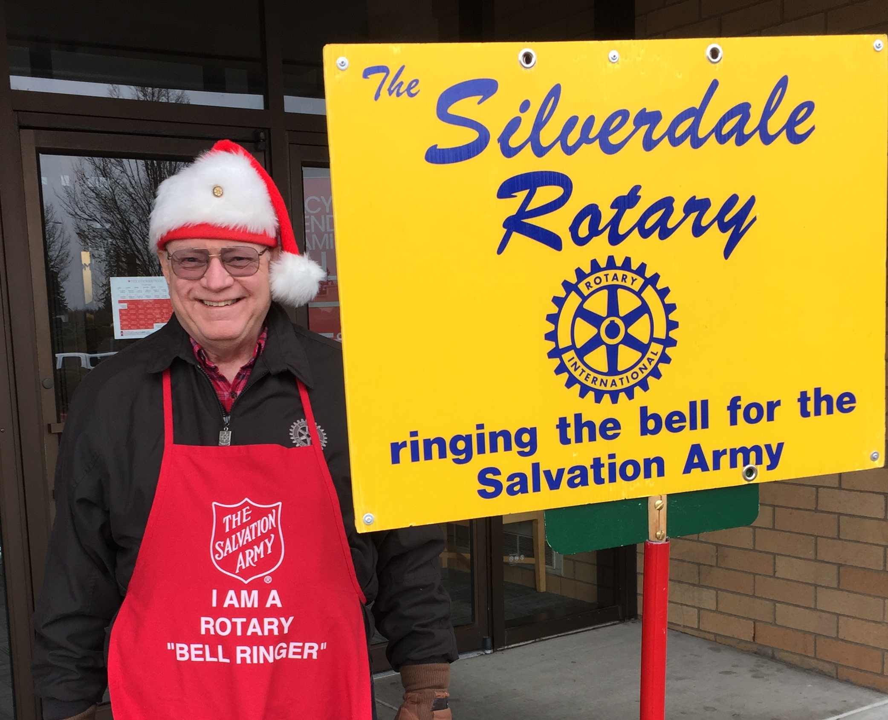
Bell Ringing
Spelling Bee
Cheering Section

Slide 7
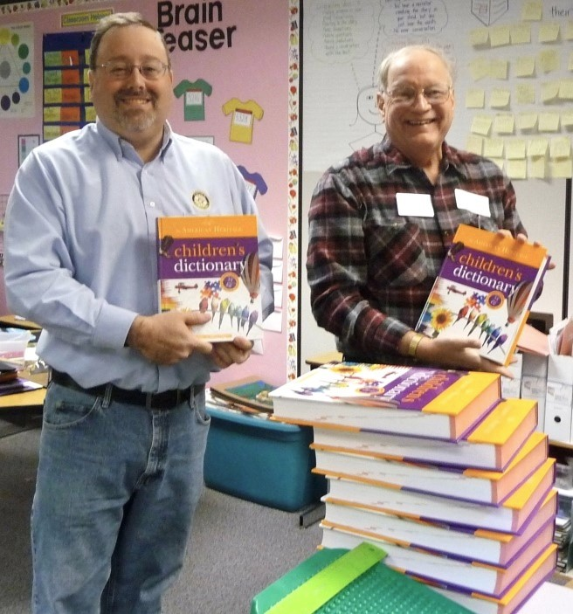
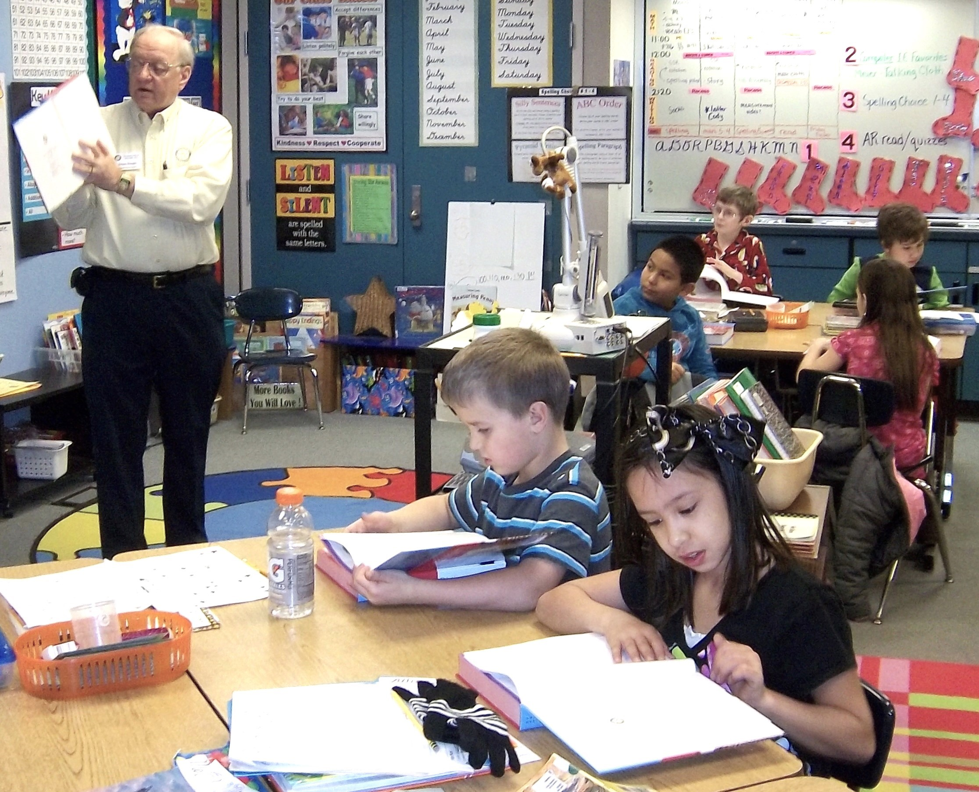
Third Grade Dictionaries

